Slide 1
Crucial Feature Extraction for NLP Insights M.Tech DSc&AI
Dr. Dheeraj Kodati
Assistant Professor
Mahindra University
Hyderabad

Slide 2
Natural Language Processing
Natural Language Processing (NLP) is an AI branch that enables computers to understand text and spoken words like humans.
It combines machine learning, statistics, and deep learning with computational linguistics to help computers understand text, spoken words, human language, intent, and sentiment.
•
•

Slide 3
Natural Language Processing
•
Humans communicate using words and text, a method known as Natural Language. They share vast amounts of information daily in various languages through speech or text.
Computers cannot interpret natural language data, as they communicate in 1s and 0s. This data is valuable and can offer insights, so computers need to understand, emulate, and respond intelligently to human speech.
•

Slide 4
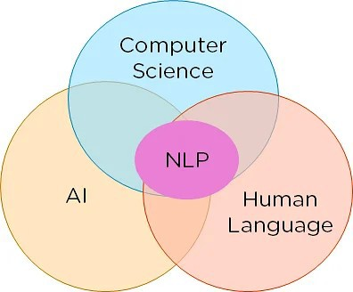
Natural Language Processing
•
NLP combines linguistics and computer science to create models that understand, analyze, and extract meaningful details from text and speech.

Slide 5
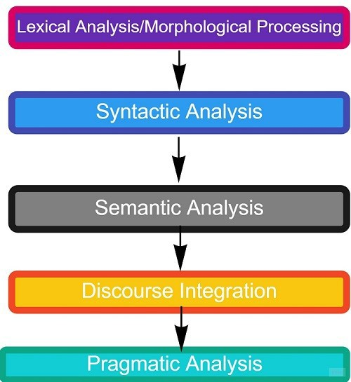
Phases of NLP

Slide 6
Lexical Analysis
•
The first phase is lexical analysis/morphological processing. In this phase, the sentences, paragraphs are broken into tokens.
These tokens are the smallest unit of text. It scans the entire source text and divides it into meaningful lexemes.
For example, The sentence “He goes to college.” is divided into [ ‘He’ , ‘goes’ , ‘to’ , ‘college’, ‘.’] .
There are five tokens in the sentence. A paragraph may also be divided into sentences.
•
•
•

Slide 7
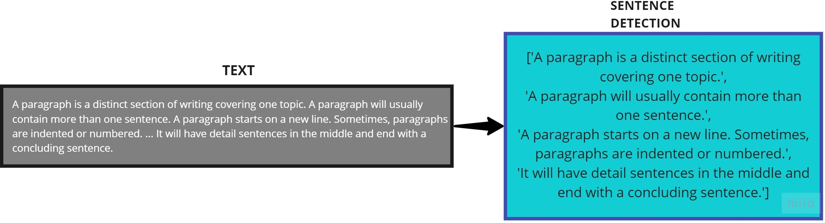
Lexical Analysis

Slide 8
Syntactic Analysis/Parsing
•
The second phase is Syntactic analysis. In this phase, the sentence is checked whether it is well- formed or not.
The word arrangement is studied and a syntactic relationship is found between them. It is checked for word arrangements and grammar.
For example, the sentence “Delhi goes to him” is rejected by the syntactic parser.
•
•

Slide 9
Semantic Analysis
•
The third phase is Semantic Analysis. In this phase, the sentence is checked for the literal meaning of each word and their arrangement together.
For example, The sentence “I ate hot ice cream” will get rejected by the semantic analyzer because it doesn’t make sense.
E.g.. “colorless green idea.” This would be rejected by the Symantic analysis as colorless. Here; green doesn’t make any sense.
•
•

Slide 10
Discourse Integration
•
The fourth phase is discourse integration. In this phase, the impact of the sentences before a particular sentence and the effect of the current sentence on the upcoming sentences is determined.
For example, the word “that” in the sentence “He wanted that” depends upon the prior discourse context.
•

Slide 11
Pragmatic Analysis
•
The last phase of natural language processing is Pragmatic analysis. Sometimes the discourse integration phase and pragmatic analysis phase are combined.
The actual effect of the text is discovered by applying the set of rules that characterize cooperative dialogues.
E.g., “close the window?” should be interpreted as a request instead of an order.
•
•

Slide 12
NLP Implementation
•
Below, given are popular methods used for Natural Learning Process:
– Machine learning: Machine learning NLP procedures prioritize common cases, while hand-written rules may contain human errors.
– Statistical inference: NLP can utilize statistical inference algorithms to produce robust models, including widely known words or structures.

Slide 13
NLP Steps
•
How to Perform NLP?
Segmentation
Tokenizing
Removing Stop Words:
Stemming
Lemmatization
Part of Speech Tagging
Named Entity Tagging

Slide 14
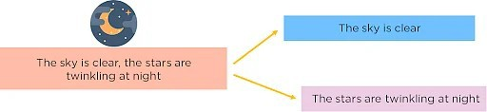
Segmentation
We first need to break the entire document down into its constituent sentences. We can do this by segmenting the article along with its punctuation like full stops and commas.

Slide 15
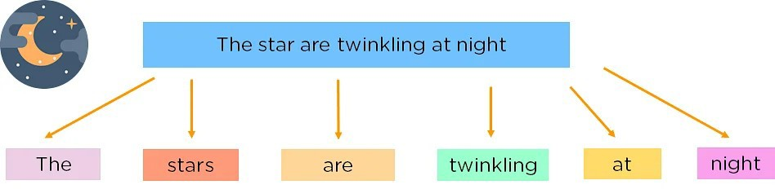
Tokenizing
•
For the algorithm to understand these sentences, we need to get the words in a sentence and explain them individually to our algorithm.
So, our break down our sentence into its constituent words and store them. This is called tokenizing, and each word is called a token.
•

Slide 16
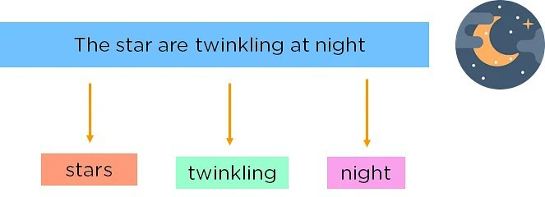
Removing Stop Words
•
•
We can make the learning process faster by getting rid of non-essential words, which add little meaning to our statement and are just there to make our statement sound more cohesive.
Words such as was, in, is, and, the, are called stop words and can be removed.

Slide 17
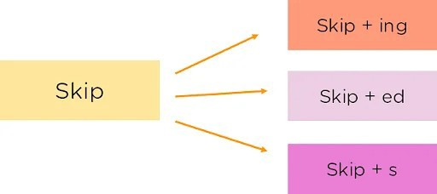
Stemming
•
It is the process of obtaining the Word Stem of a word. Word Stem gives new words upon adding affixes to them

Slide 18
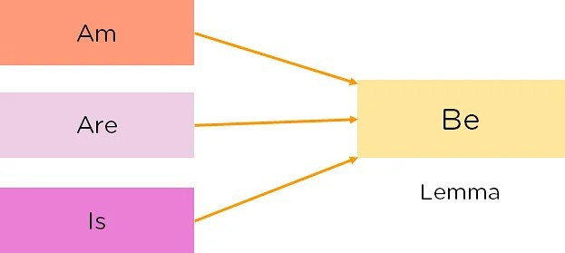
Lemmatization
•
•
The process of obtaining the Root Stem of a word. Root Stem gives the new base form of a word that is present in the dictionary and from which the word is derived.
We can also identify the base words for different words based on the tense, mood, gender,etc.

Slide 19
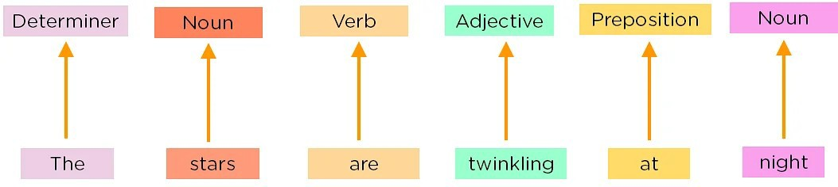
Part of Speech Tagging
•
Now, we must explain the concept of nouns, verbs, articles, and other parts of speech to the machine by adding these tags to our words. This is called ‘part of speech taggers’.

Slide 20
Named Entity Tagging
Next, introduce our machine to pop culture references and everyday names by flagging names of movies, important personalities or locations, etc that may occur in the document.
We do this by classifying the words into subcategories. This helps in finding any keywords in a sentence. The subcategories are person, location, monetary value, quantity, organization, and movie.
After performing the preprocessing steps, you then give your resultant data to a machine learning algorithm like Naive Bayes, etc., to create our NLP application.

Slide 21
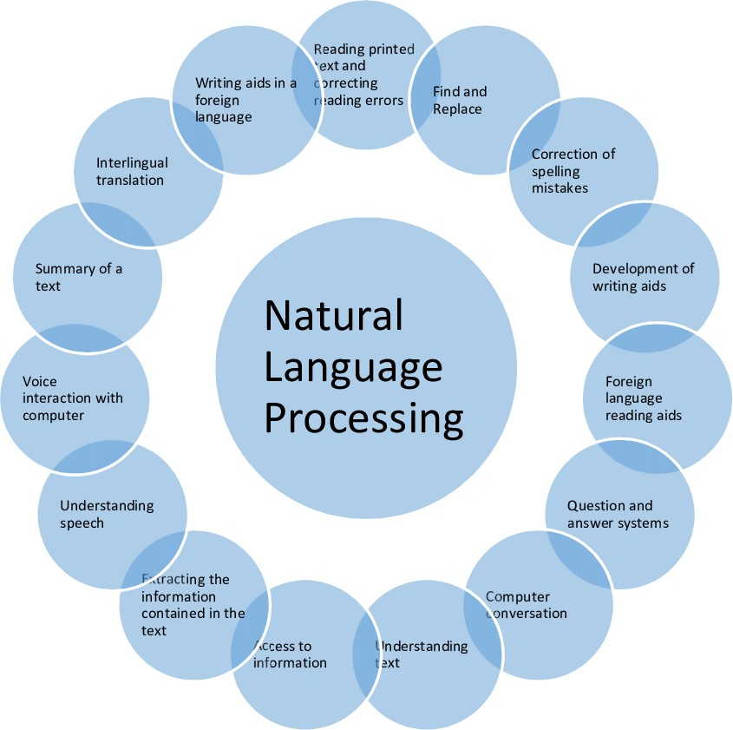
Applications of NLP

Slide 22
Applications of NLP
NLP is one of the ways that people have humanized machines and reduced the need for labor.
It has led to the automation of speech-related tasks and human interaction. Some applications of NLP include:
Translation Tools: Tools such as Google Translate, Amazon Translate, etc. translate sentences from one language to another using NLP.
Chatbots: Chatbots can be found on most websites and are a way for companies to deal with common queries quickly.

Slide 23
Applications of NLP
Virtual Assistants: Virtual Assistants like Siri, Cortana, Google Home, Alexa, etc can not only talk to you but understand commands given to them.
Targeted Advertising: Have you ever talked about a product or service or just googled something and then started seeing ads for it?
This is called targeted advertising, and it helps generate tons of revenue for sellers as they can reach niche audiences at the right time.
Autocorrect: Autocorrect will automatically correct any spelling mistakes you make, apart from this grammar checkers also come into the picture which helps you write flawlessly.

Slide 24
Applications of NLP
•
Information retrieval & Web Search: Google, Yahoo, Bing, and other search engines base their machine translation technology on NLP deep learning models.
It allows algorithms to read text on a webpage, interpret its meaning and translate it to another language.
Grammar Correction: NLP technique is widely used by word processor software like MS-word for spelling correction & grammar check.
•
•

Slide 25
Applications of NLP
Question Answering
Type in keywords to ask Questions in Natural Language.
Text Summarization
The process of summarising important information from a source to produce a shortened version
Machine Translation
Use of computer applications to translate text or speech from one natural language to another.

Slide 26
Future of NLP
Human readable natural language processing is the biggest Al- problem.
It is all most same as solving the central artificial intelligence problem and making computers as intelligent as people.
Future computers or machines with the help of NLP will able to learn from the information online and apply that in the real world, however, lots of work need to on this regard.
Nltk, when paired with natural language generation, enhances computer capabilities for exchanging valuable information.

Slide 27
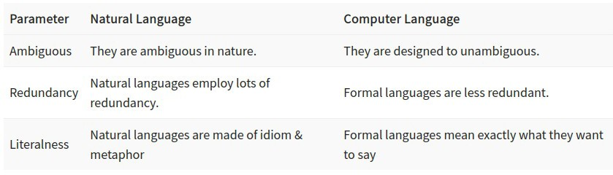
Natural Language vs. Computer Language

Slide 28
Advantages of NLP
Users can ask questions about any subject and get a direct response within seconds.
NLP systems provide precise answers in natural language, omitting unnecessary information.
The accuracy of the answers increases with the amount of relevant information provided in the question.
Enables us to conduct extensive language-based data comparisons without fatigue, bias, or inconsistency, unlike humans.
Structuring a highly unstructured data source.

Slide 29
Disadvantages of NLP
Complex Query Language- the system may not be able to provide the correct answer, if the question that is poorly worded or ambiguous.
The system is built for a single and specific task only; it is unable to adapt to new domains and problems because of limited functions.
NLP system doesn’t have a user interface which lacks features that allow users to further interact with the system.

Slide 30
Thank You

